Slide 1
Session tracking
HTTP is a stateless protocol that provides no way for a server to recognize that a sequence of requests comm. From the same client.
But many web applications are not stateless.
A server can not identify the client by the ip address,
because the reported ip address may be the address of a proxy server or the address of a server machine that hosts several clients.
Session tracking gives servlets and other server-side applications the ability to keep track of the user as the user moves through the site.
Web server maintains user state by creating a session object for each user with a unique session id.
The session object is passed as part of the request.
Servlets can add information to session object and read information from them.

Slide 2
What is Session Tracking?
HTTP is a "stateless" protocol.
when you are doing on-line shopping,
the Web server can't easily remember previous transactions.
This makes applications like shopping carts very problematic:
when you add an entry to your cart,
how does the server know what's already in your cart?
When you move from the page where you specify what you want to buy
(hosted on the regular Web server)
to the page that takes your credit card number and
shipping address (hosted on the secure server that uses SSL), how does the server remember what you were buying?

Slide 3


Session Management – Session Tracking
new
How sessions work?
1
2
request, “dark”
ID# 42
“dark”
HttpSession
Client A
response, ID# 42
setAttribute(“dark”)
4
3
Container
ID# 42
“dark”
“ale”
#42
Client A
1
HttpSession
request, “ale”, ID# 42
2
Container

Slide 4
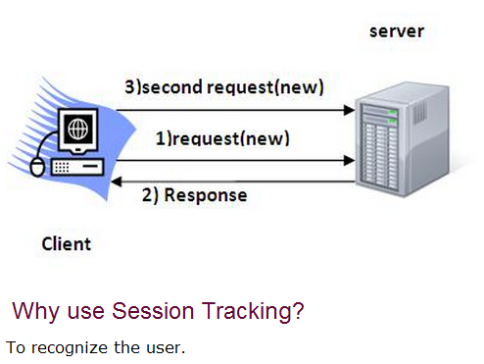

Slide 5
There are four typical solutions to this problem.
1. Cookies.
2. URL Rewriting.
3. Hidden form fields.
4. HTTP Session

Slide 6
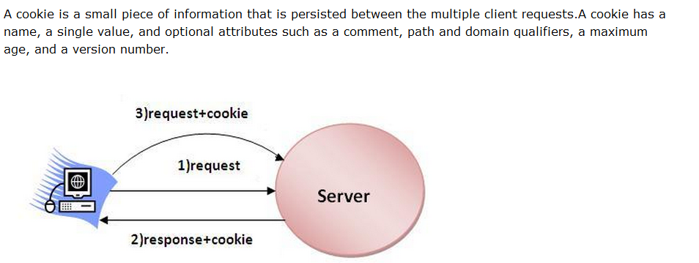

Slide 7
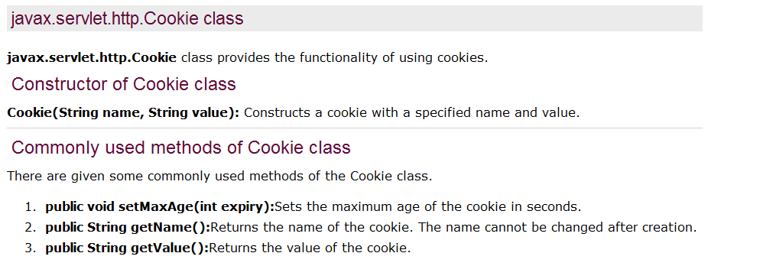

Slide 8
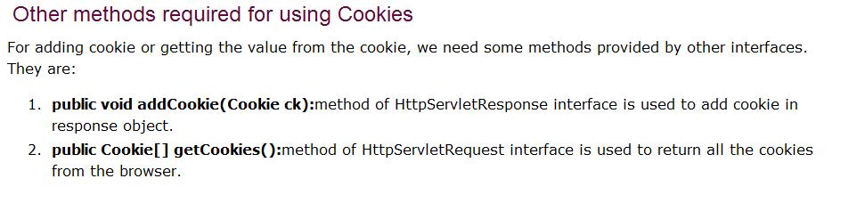

Slide 9

Session Tracking – Cookies
Here’s your cookie with session ID inside…
HttpSession session = request.getSession();
HTTP/1.1 200 OK
Set-Cookie: JSESSIONID=0ABS
Content-Type: text/html
Server: Apache-Coyote/1.1
<html>
…
</html>
Client A
OK, here’s the cookie with my request
Container
HTTP Response
POST / login.do HTTP/1.1
Cookie: JSESSIONID=0ABS
Accept: text/html……
Client A
HTTP Request
Container

Slide 10
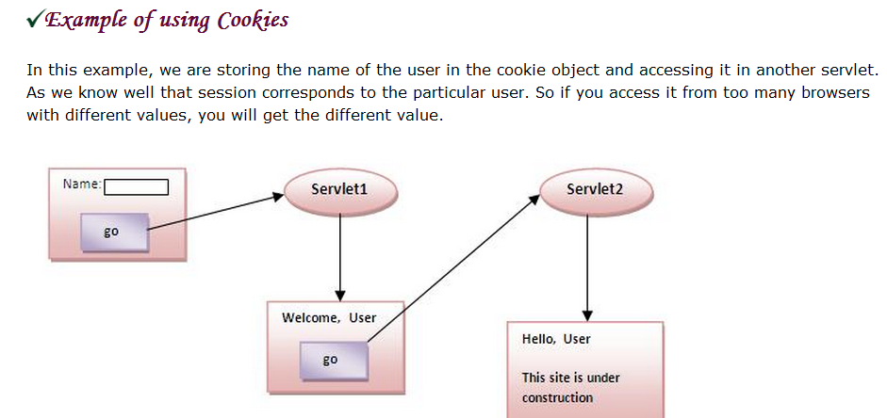

Slide 11
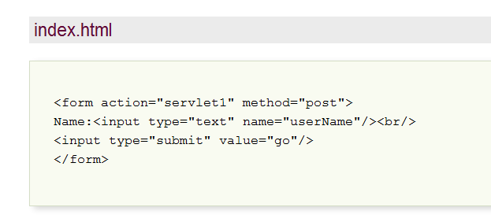

Slide 12
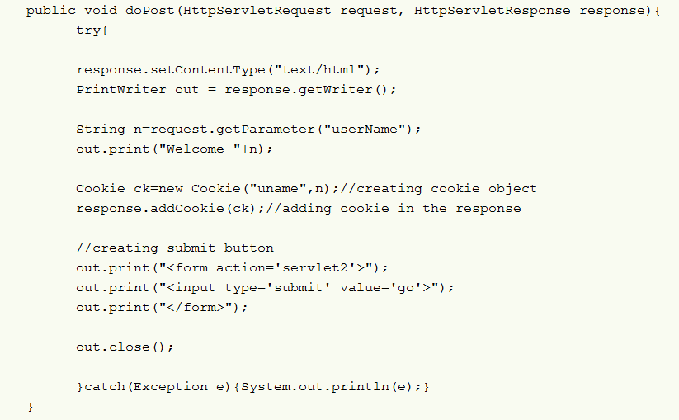
First servlet

Slide 13
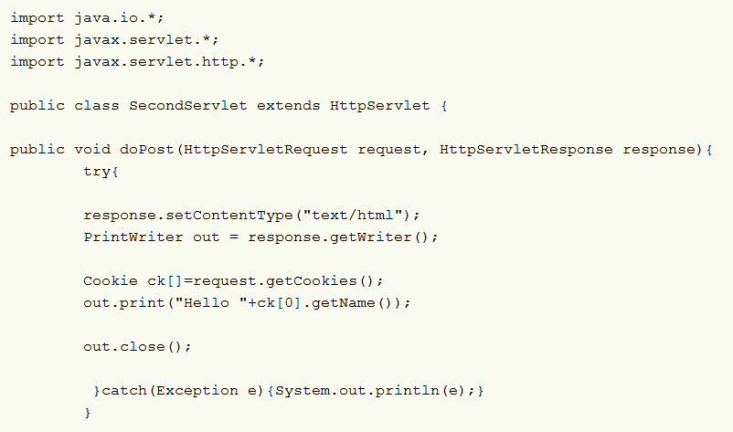
Second servlet

Slide 14
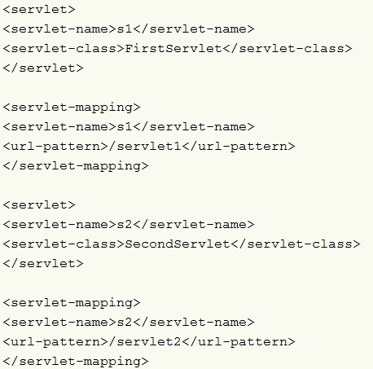
Web.xml

Slide 15
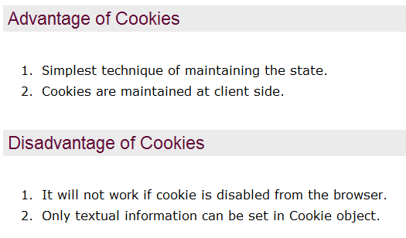

Slide 16
URL Rewriting.
You can append some extra data on the end of each URL that identifies the session,
and the server can associate that session identifier with data it has stored about that session.
This is also an excellent solution, and
even has the advantage that it works with browsers that don't support cookies or where the user has disabled cookies.
However, it has most of the same problems as cookies,
namely that the server-side program has a lot of straightforward but tedious processing to do.
In addition, you have to be very careful that every URL returned to the user
(even via indirect means like Location fields in server redirects) has the extra information appended.
And, if the user leaves the session and comes back via a bookmark or link, the session information can be lost.

Slide 17
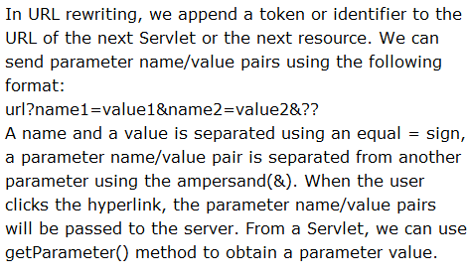
Session tracking-url rewriting

Slide 18
Session Tracking – URL Rewriting
URL ;jsessionid=1234567
Container
HTTP/1.1 200 OK
Content-Type: text/html
Server: Apache-Coyote/1.1
<html>
<body>
< a href =“ http:// www.sharmanj.com/Metavante;jsessionid=0AAB”>
click me </a>
</html>
Client A
HTTP Response
GET /Metavante;jsessionid=0AAB
HTTP / 1.1
Host: www.sharmanj.com
Accept: text/html
Client A
HTTP Request
Container

Slide 19
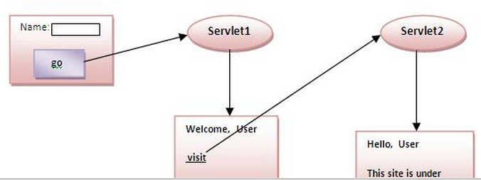

Slide 20
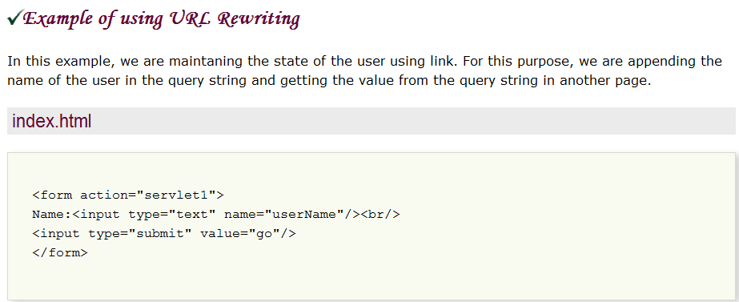

Slide 21
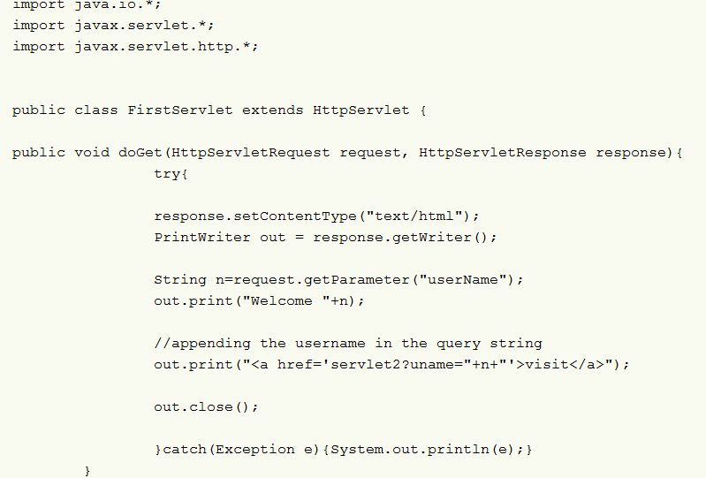
First servlet

Slide 22
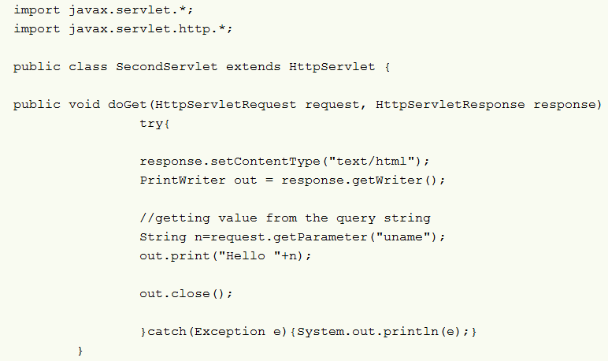
second servlet

Slide 23
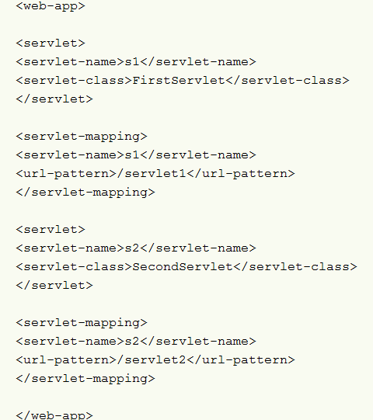

Slide 24
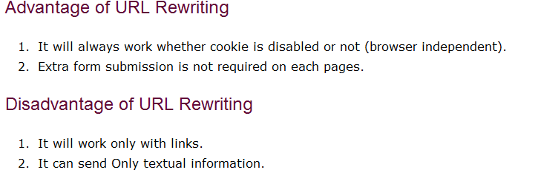

Slide 25
Hidden form fields.
HTML forms have an entry that looks like the following:
<INPUT TYPE="HIDDEN" NAME="session" VALUE="...">.
when the form is submitted,
the specified name and value are included in the GET or POST data.
This can be used to store information about the session. Disadvantage
that it only works if every page is dynamically generated,
since the whole point is that each session has a unique identifier.

Slide 26
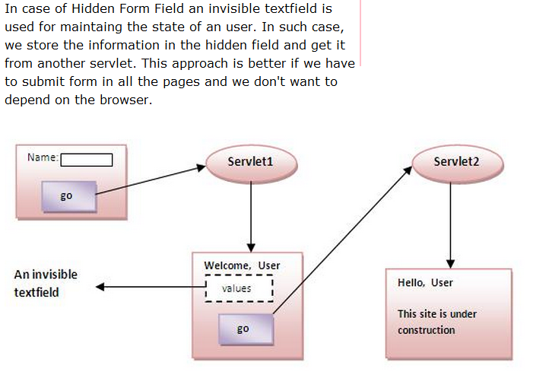
3.Hidden form field

Slide 27
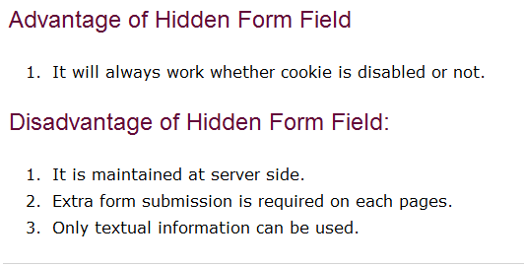

Slide 28
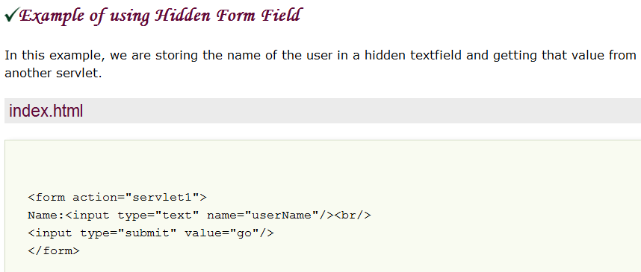

Slide 29
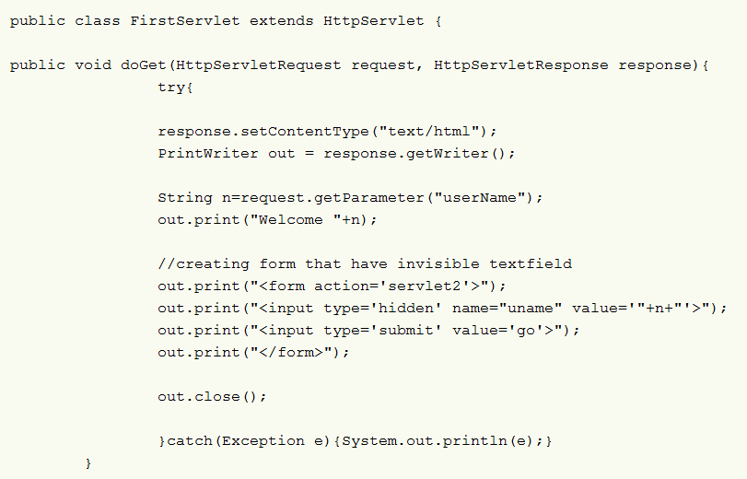

Slide 30
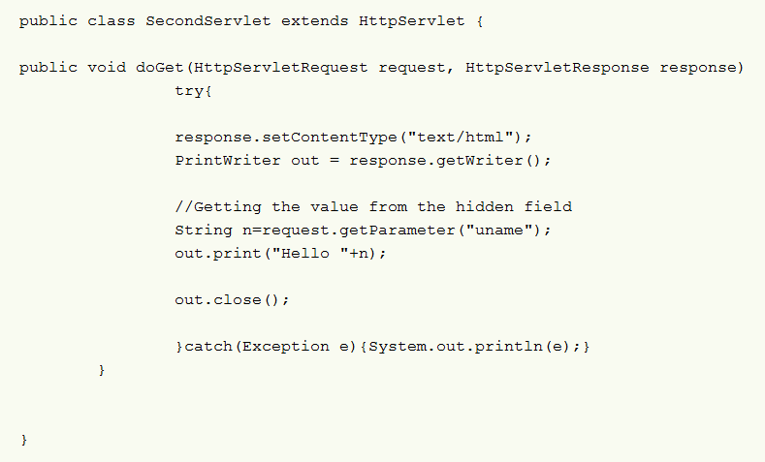

Slide 31
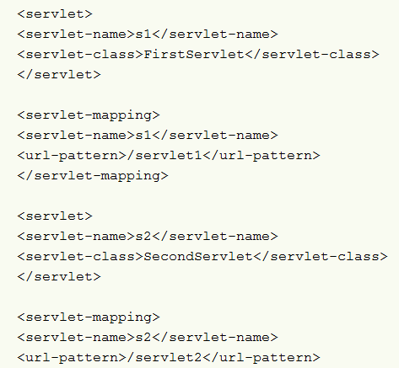
Web.xml

Slide 32
HttpSession API.
This is a high-level interface built on top of cookies or URL-rewriting.
In fact, on many servers, they use cookies if the browser supports them,
but automatically revert to URL-rewriting when cookies are unsupported or explicitly disabled. But the servlet author doesn't need to bother with many of the details,
doesn't have to explicitly manipulate cookies or information appended to the URL, and
is automatically given a convenient place to store data that is associated with each session.

Slide 33
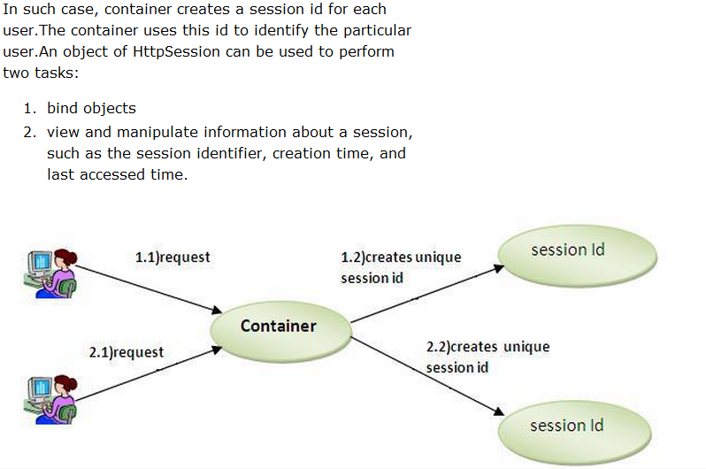
4.HttpSession

Slide 34
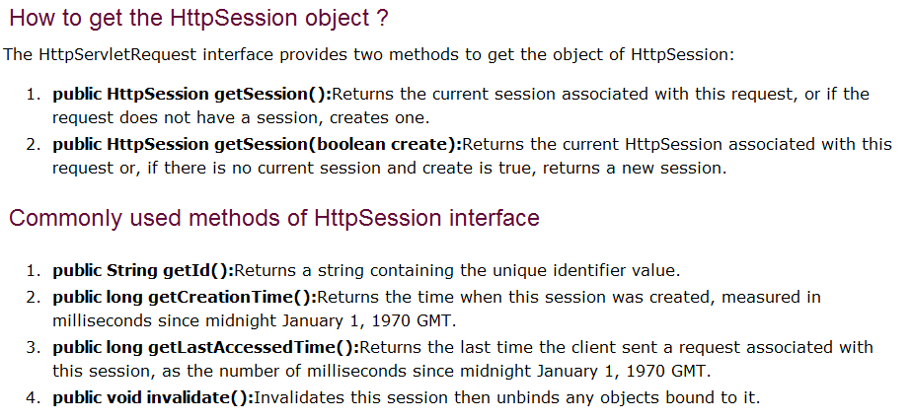

Slide 35
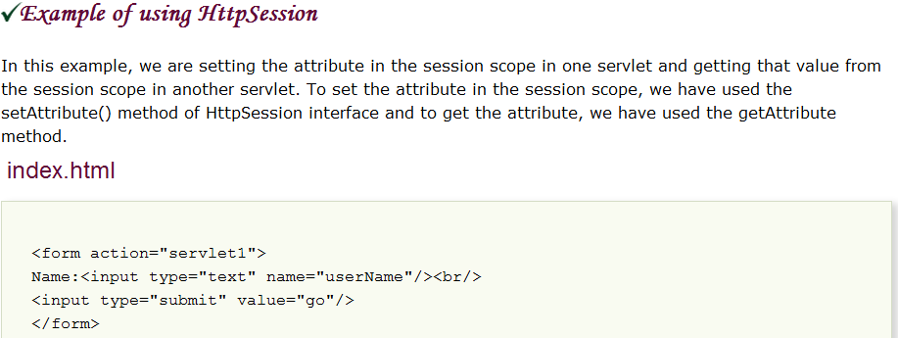

Slide 36
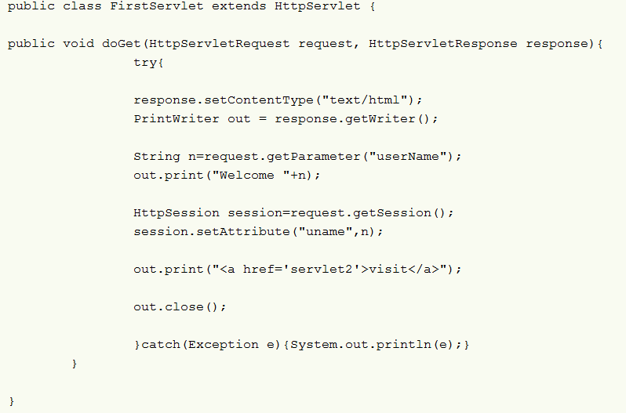
First servlet

Slide 37
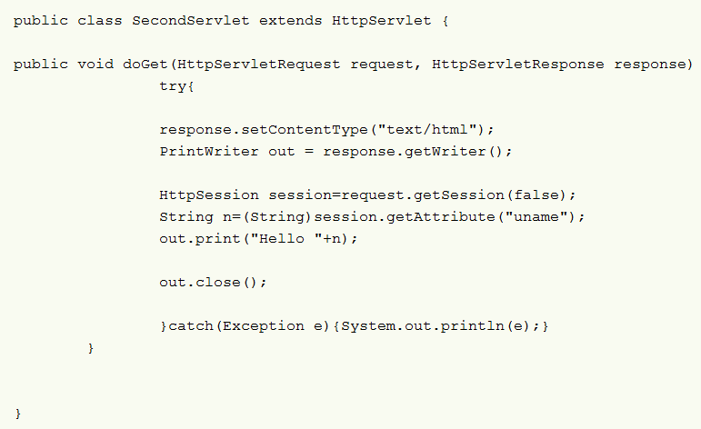
Second servlet

Slide 38
